Slide 1
Objectives
Type of endotracheal tubes.
Laryngeal mask airway.
Oropharyngeal airway.
Nasophryngeal airway.

Slide 2
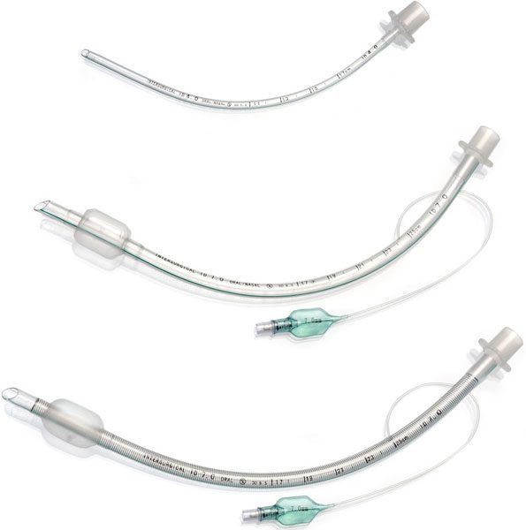
Types of endotracheal tubes

Slide 3
Diameter and length
Diameter:
    Adult male = 8-9 mm.
    Adult female = 7-8.5 cm.
    Pediatric = (age/4) + 4 mm
Length:
    Oral intubation in adult = 20-30 cm.
    Oral intubation in children = (age/2) + 12 cm.
    Nasal intubation in children = (age/2) + 15cm.

Slide 4
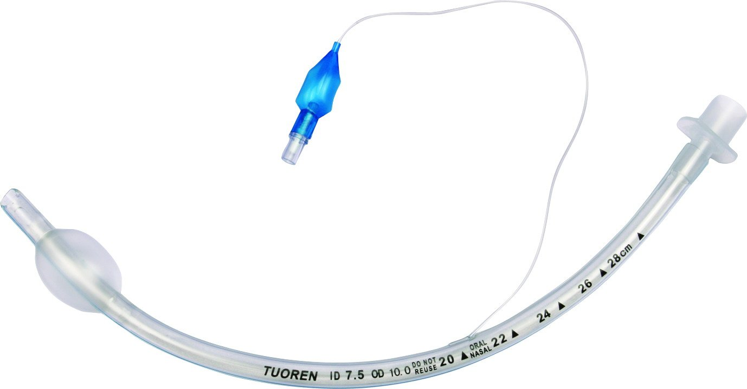
Shape
Curved:
    These should be cut to the correct length as there is a risk accidental intubation of a bronchus (usually the right main bronchus) if the tip is inserted too far.

Slide 5
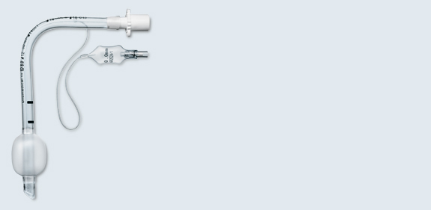
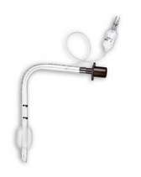
Shape (con…)
Oxford:
    is L-shaped and the angle of the tubes lies in the pharynx; the distal end is of a fixed length.
    It is claimed that the use of an Oxford tube reduces the risk of bronchial intubation.
    There may be less risk of an Oxford tube kinking if the head id flexed during surgery.
    However, an introducer is required to pass an Oxford tube through the larynx.

Slide 6
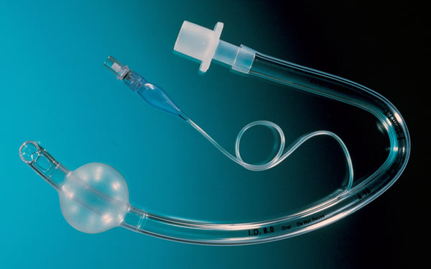
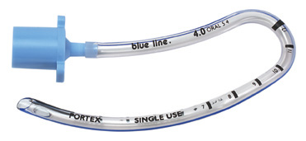
Shape (con…)
RAE (Ring-Adair-Elwyn) tubes:
    Pre-formed curves and they can be used either orally or nasally.

Slide 7
Cuff
Low volume high pressure:
    Require inflation to a high pressure to effect a seal with trachea.
    The pressure within a low volume cuff does not relate to the pressure exerted by the cuff on the trachea.
    However, a high pressure may be exerted on the mucosa if the cuff is overinflated. This may occur inadvertently during anesthesia because nitrous oxide diffuse through some type of plastic.
    Some anaesthetists innate the cuff with an oxygen/nitrous mixture to obviate this problem. Alternatively. The cuff volume may be readjusted after 10-15 min of anaesthesia.

Slide 8
Cuff (con…)
High volume low pressure:
    Cover a larger area of tracheal wall and may effect a seal with less pressure exerted on the mucosa.
    However, they may cause more trauma during insertion and may become puckered in relatively small trachea.
    Herniation of an overinflated cuff may occlude the distal end of the tracheal tube and cause partial or total airway obstruction.

Slide 9
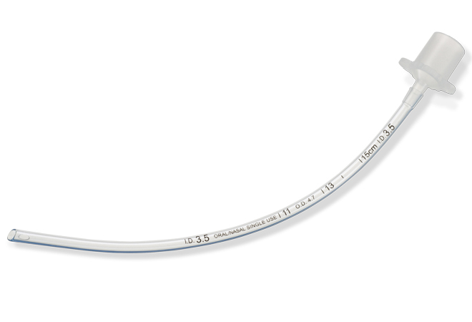
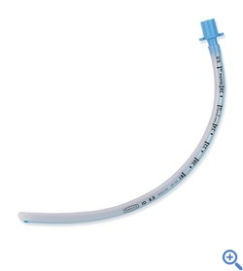
Uncuffed
Are used in children.

Slide 10
Specialized
Armoured latex tube.
Flexometallic tubes.
Flexible metal tube.
Parker tube.
Combitube.
Double-lumen tube.

Slide 11
Laryngeal mask airway (LMA)

Slide 12
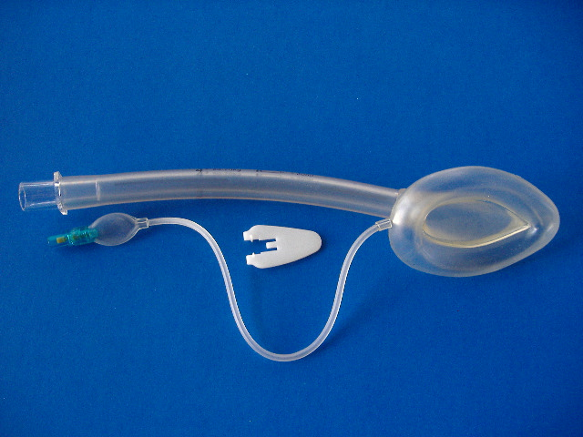
It consists of a mask that sits over the laryngeal opening, attached to which is a tube that protrudes from the mouth and connects directly to the anaesthetic breathing system.

Slide 13
The LMA is produced in a variety of sizes suitable for all patients, from neonates to adults, with sizes 3, 4 and 5 being the most commonly used in female and male adults.
Patients can be ventilated via the LMA provided that high inflation pressures are avoided, otherwise leakage occurs past the cuff.

Slide 14
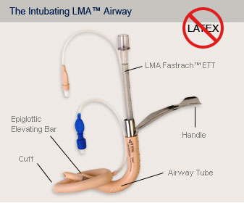
Types
Intubating LMA:
    Used as conduit to perform tracheal intubation the need for laryngoscopy.

Slide 15
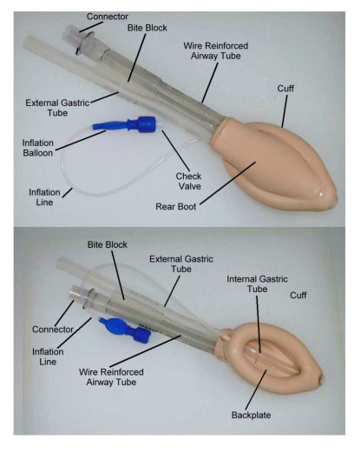
Types (con…)
Peoseal LMA:
    Has an additional posterior cuff to improve the seal around the larynx and reduce leak when the patient is ventilated.
    It also has a secondary tube to allow drainage of gastric contents.

Slide 16
Technique for insertion
The patient’s reflexes must be suppressed to a level similar to that required for the insertion of an oropharyngeal airway to prevent coughing or laryngospasm.
Cuff is deflated and the mask lightly lubricated.
Head tilt is performed, the patient’s mouth opened fully and the tip of the mask inserted along the hard palate with the open side facing but not touching the tongue.
The mask is further inserted, using the index to provide support for the tube. Eventually, resistance will be felt at the point where the tip of the mask lies at the upper esophageal sphincter.

Slide 17
Technique for insertion (con…)
The cuff is now fully inflated using an air-filled syringe attach to the valve at the end of the pilot tube.
The laryngeal mask is secured either by a length of bandage adhesive strapping attached to the protruding tube.
A ‘bite block’ may be inserted to reduce the risk of damage to the LMA at recovery.

Slide 18
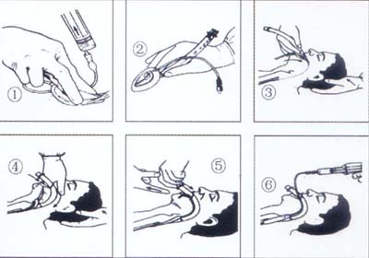
Technique for insertion (con…)

Slide 19
Oropharyngeal (Guedel) airway

Slide 20
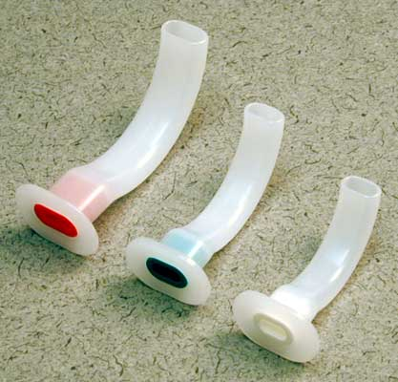
Curved plastic tubes, flattened in cross-section and flanged at the oral end.

Slide 21
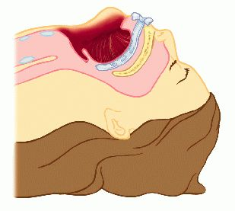
They lie over the tongue, preventing it from falling back into the pharynx.

Slide 22
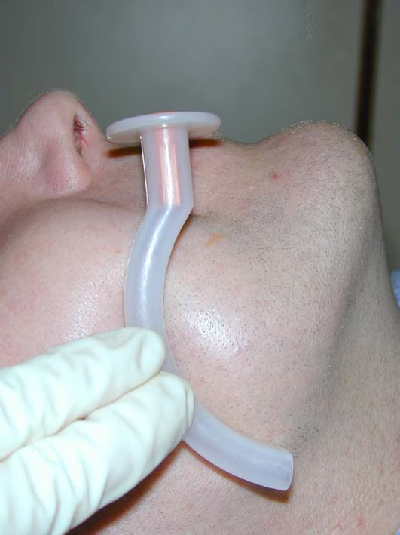
Available in a variety of sizes suitable for all patients, from neonates to large adults. The commonest sizes are 2-4, for small to large adults, respectively.
An estimate of the size required is given by comparing the airway length with the vertical distance between the patient’s incisor teeth and the angle of the jaw.

Slide 23
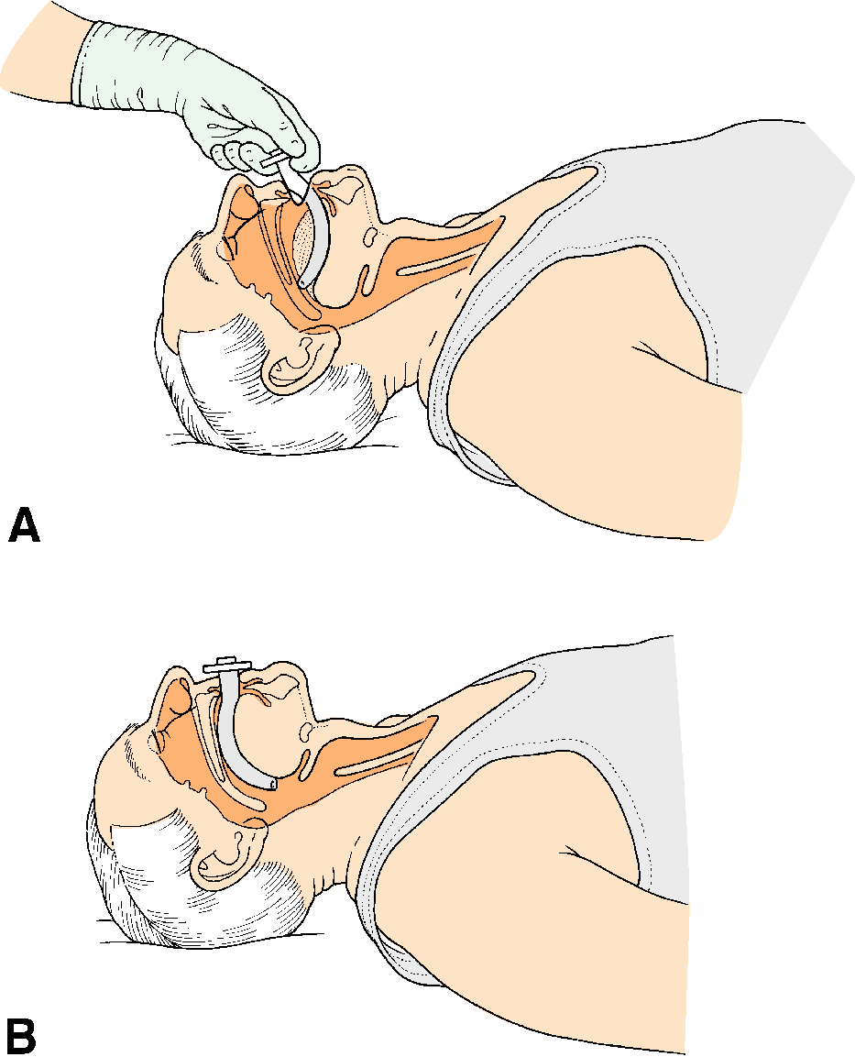
Initially inserted ‘upside down’ as far as the back of the hard palate, rotated 180 degree and fully inserted until thee flange lies in front of the teeth, or gums in an edentulous patient.

Slide 24
Nasopharyngeal airway

Slide 25
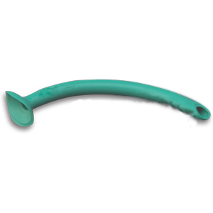
Round, malleable plastic tube, bevelled at the pharyngeal end and flanged at the nasal end.

Slide 26
Sized on their internal diameter in millimeter, length increasing with diameter. The common sizes in adults are 6-8 mm.
A guide to the correct sized is made by comparing the diameter to the external nares.
Prior to insertion , the patency of the nostril (usually the right) should be checked and the airway lubricated.

Slide 27
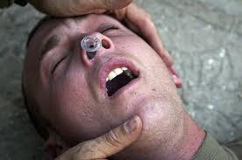
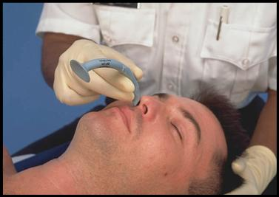
The airway is inserted along the floor of the nose, with the bevel facing medially to avoid catching the turbinates.

Slide 28
A safety pin may be inserted through the flange to prevent inhalational of the airway.
If obstruction in encountered, force should not be used as severe bleeding may be provoked. Instead, the other nostril can be tried.

